Slide 1
Testing strategy in Waterfall Model
The role of a tester is extremely important. In Waterfall projects, tests are usually conducted at the final stages of their realization. That is why testers have to find all bugs in final products and return the software to the developers so that they can fix all defects. Both individual components and the integrated whole are methodically verified to ensure that they are error-free and fully meet the requirements outlined in the first step. An independent quality assurance team defines “test cases” to evaluate whether the product fully or partially satisfies the requirements outlined in the first step. Three types of testing typically take place: unit testing of individual code modules; system testing of the integrated product; and acceptance testing, formally conducted by or on behalf of the customer. Defects, if found, are logged and feedback provided to the implementation team to enable correction. This is also the stage at which product documentation, such as a user manual, is prepared, reviewed and published.

Slide 2
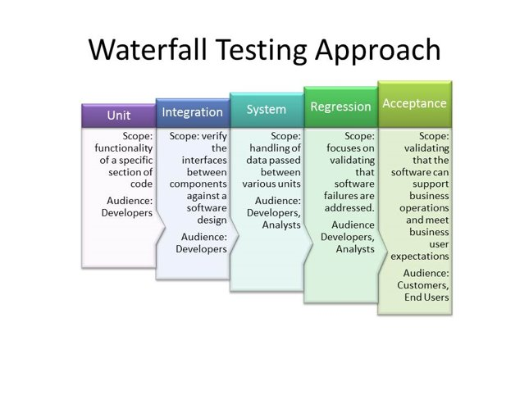

Slide 3
Inputs and Outputs for the Waterfall Test Process
Activity | Inputs | Outputs
Requirements analysis | Requirements definition, requirements specification | Requirements traceability matrix
Test planning | Requirements specification, requirements trace matrix | Test plan—test strategy, test system, effort estimate and schedule
Test design | Requirements specification, requirements trace matrix, test plan | Test designs—test objectives, test input specification, test configurations

Slide 4
Activity | Inputs | Outputs
Test implementation | Software functional specification, requirements trace matrix, test plan, test designs | Test cases—test procedures and automated tests
Test debugging | "Early look" build of code, test cases, working test system | Final test cases
System testing | System test plan, requirements trace matrix, "test-ready" code build, final test cases, working test system | Test results—bug reports, test status reports, test results summary report

Slide 5
Activity | Inputs | Outputs
Acceptance testing | Acceptance test plan, requirements trace matrix, beta code build, acceptance test cases, working test system | Test results
Operations and maintenance | Repaired code, test cases to verify bugs, regression test cases, working test system | Verified bug fixes

